Slide 1
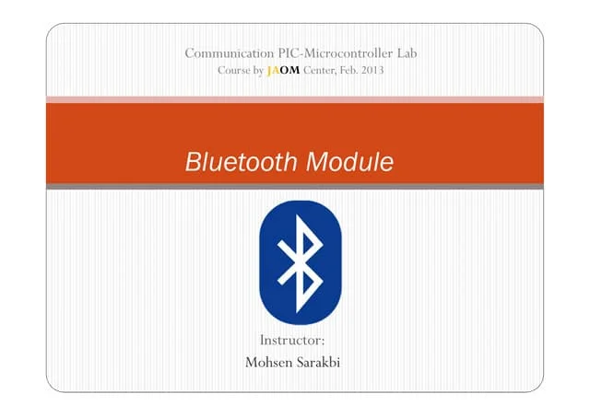

Slide 2
Content
What is Bluetooth Module?
Types of Bluetooth Module
How does Bluetooth module work?
Examples of Bluetooth module?
Bluetooth module benefits to organizations
Why is Bluetooth module so important
Challenges of Bluetooth module
Advantages
Disadvantages
Conclusion

Slide 3
What is Bluetooth Module?
A Bluetooth module is a compact electronic device that allows wireless communication between two or more devices using Bluetooth technology.
It serves as an interface between a host system—like a microcontroller, computer, or mobile device—and other Bluetooth-enabled devices.
Bluetooth modules are essential components in many modern electronic projects, especially in areas like the Internet of Things (IoT), home automation, wireless audio, and personal health devices.
Bluetooth modules are designed to transmit and receive data over short distances using radio waves in the 2.4 GHz ISM (Industrial, Scientific, and Medical) band.

Slide 4
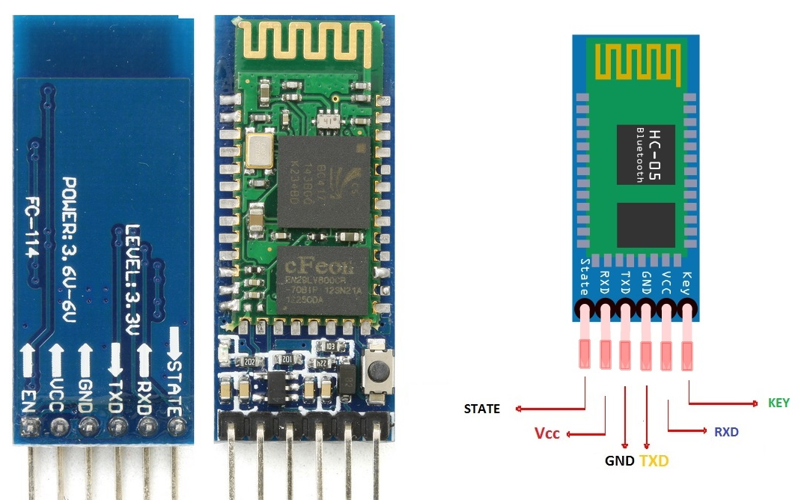
Image of a Bluetooth Module

Slide 5
Types of Bluetooth Module
There are two main categories of Bluetooth modules based on the version of Bluetooth they use:
Classic Bluetooth Modules – These support traditional Bluetooth communication and are typically used for continuous streaming of data, such as in wireless audio devices or serial data transfer. An example is the popular HC-05 module, which can function in both master and slave roles.
Bluetooth Low Energy (BLE) Modules – These are designed for minimal power consumption and are ideal for devices that transmit small amounts of data infrequently, such as fitness bands or smart sensors. A well-known BLE module is the HM-10.

Slide 6
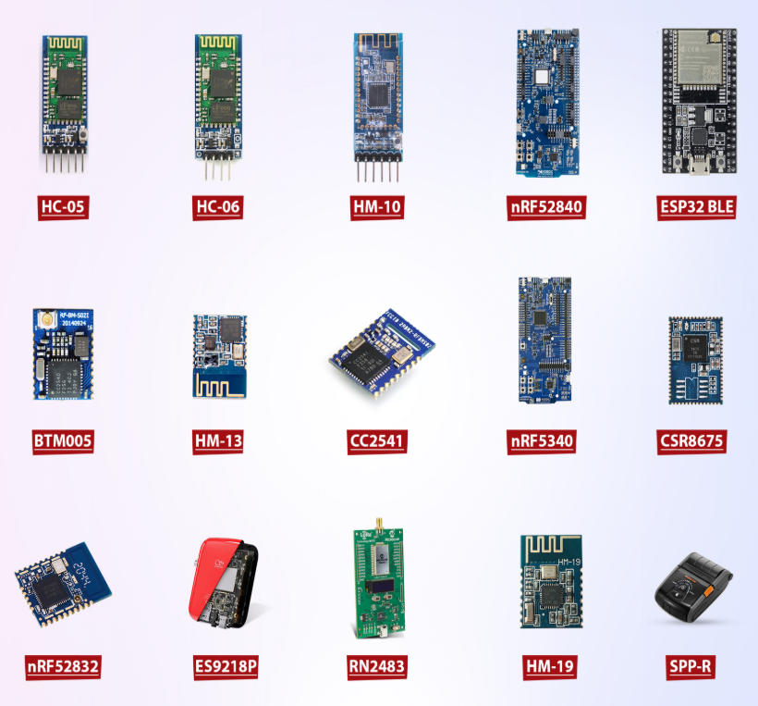
HC-05 – Classic Bluetooth module with master/slave roles for serial communication.
HC-06 – Simple slave-mode Bluetooth module for serial wireless data.
HM-10 – BLE 4.0 module compatible with iOS and Android.
nRF52840 – Advanced BLE 5.0 SoC with Thread, Zigbee, and USB support.
ESP32 BLE – Dual-core Wi-Fi and Bluetooth (Classic + BLE) microcontroller.
BTM005 – Bluetooth 2.0 SPP module with UART interface.

Slide 7
nRF5340 – Dual-core BLE 5.2 SoC for high-performance wireless applications.
HM-13 – Dual-mode Bluetooth (Classic + BLE) UART module.
CC2541 – TI BLE 4.0 module with ultra-low power consumption.
CSR8675 – High-end Bluetooth audio SoC with aptX and ANC support.
nRF52832 – BLE 5.0 SoC with good balance of power and performance.
ES9218P – Audio codec with integrated DAC and Bluetooth interface.
RN2483 – LoRa module (not Bluetooth) for long-range IoT communication.
HM-19 – BLE 5.0 module with fast data transmission and low power.
SPP-R – Serial Port Profile (SPP) Bluetooth dongle for data communication.

Slide 8
How does Bluetooth module work?
The basic purpose of these modules is to eliminate the need for wires to share data through radio waves.
These modules work over short distances only, and generally, the working principles of all the modules are more or less similar.
Here is the general way in which these modules are discussed below:
The modules have small antennas in them, and these are incorporated into the devices.
When a compatible device is turned on, it emits signals, which are captured by the module antenna. Once these devices are connected to the user confirmation, they can send the data and share information.

Slide 9
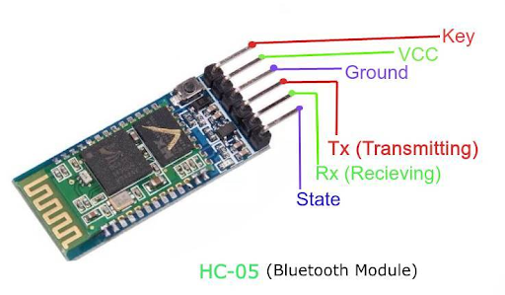
The group of multiple devices connected through Bluetooth is termed the Bluetooth network.
This large network of Bluetooth devices follows the master/slave system.
In this way, the master can connect more than one device and send and receive data from its slaves.
On the contrary, the slave can only connect with the master and send and receive data there.
There is no connection between the slave devices.
The role of the master device is most highlighted in the network, and if, for some reason, the master device fails in the connection, then the whole network is disturbed.

Slide 10
Examples of Bluetooth module?
Module Model | Type | Applications
HC-05 | Classic | Audio streaming, data transfer, file sharing, gaming
HC-06 | Classic | Data transfer, serial communication, remote control
HM-10 | Classic | Wearables, simple data transmission, microcontroller communication
nRF52840 | BLE | Wearables, Fitness trackers, Sensors, Beacons
ESP32 BLE | BLE | Smart home devices, industrial automation, IoT applications
BTM005 | BLE | Medical devices, Smartwatches, Connected toys
HM-13 | Dual-Mode | Versatile applications, Low-power sensor communication
CC2541 | Dual-Mode | Industrial automation, Smart home, Multi-protocol system

Slide 11
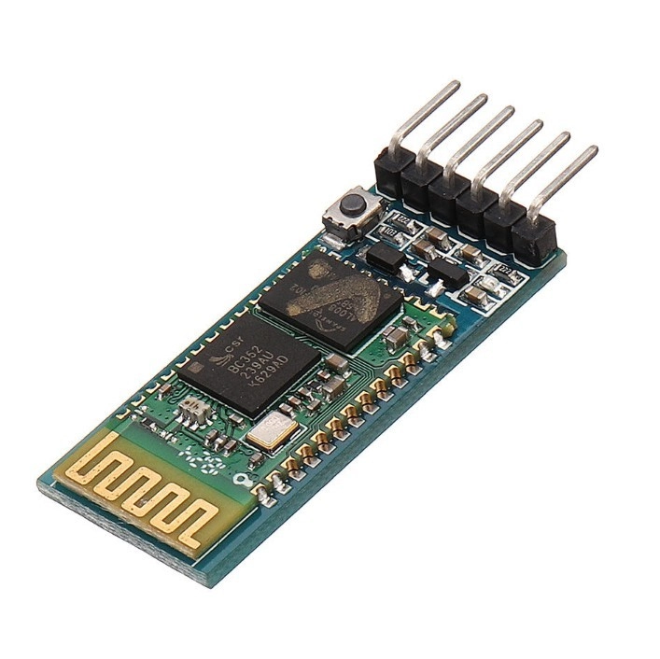
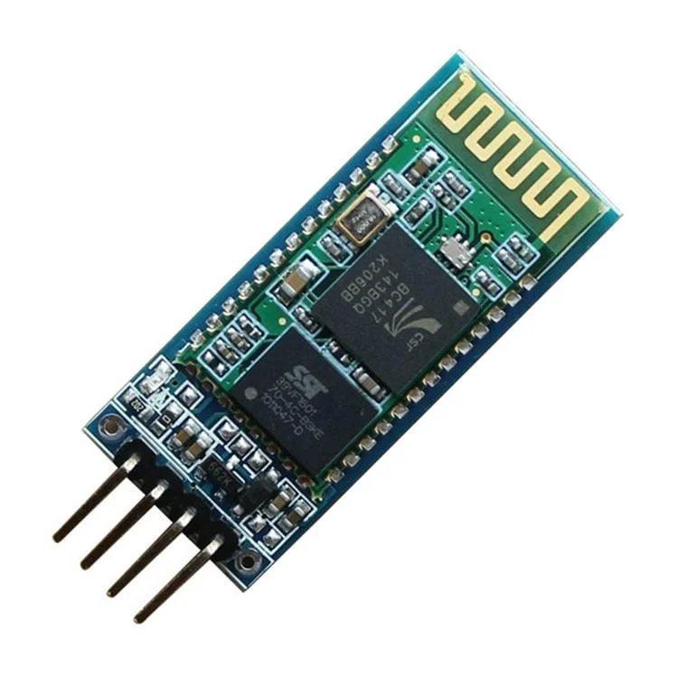
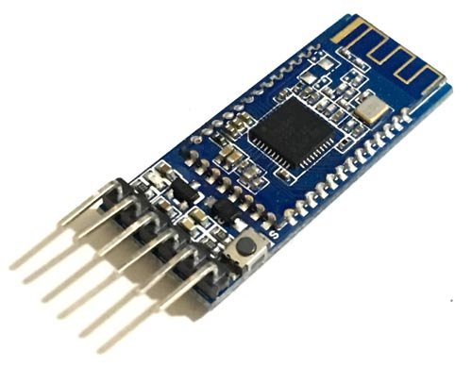
HC-05
HC-06
HM-10

Slide 12
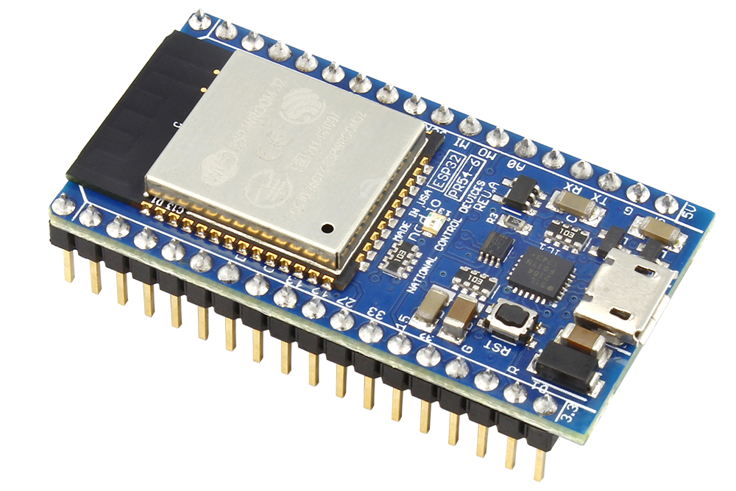
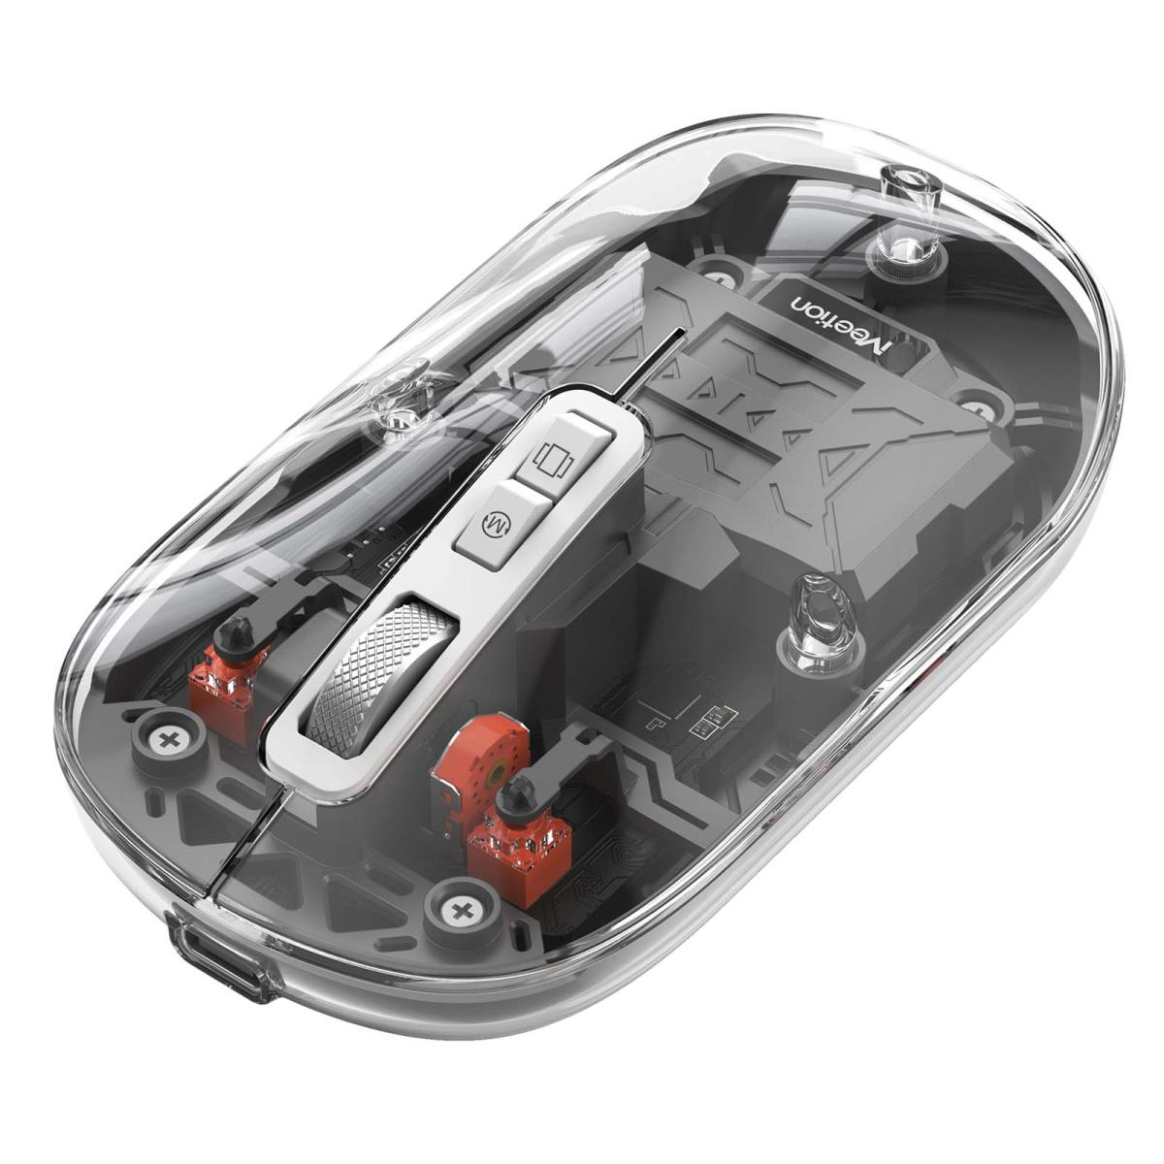
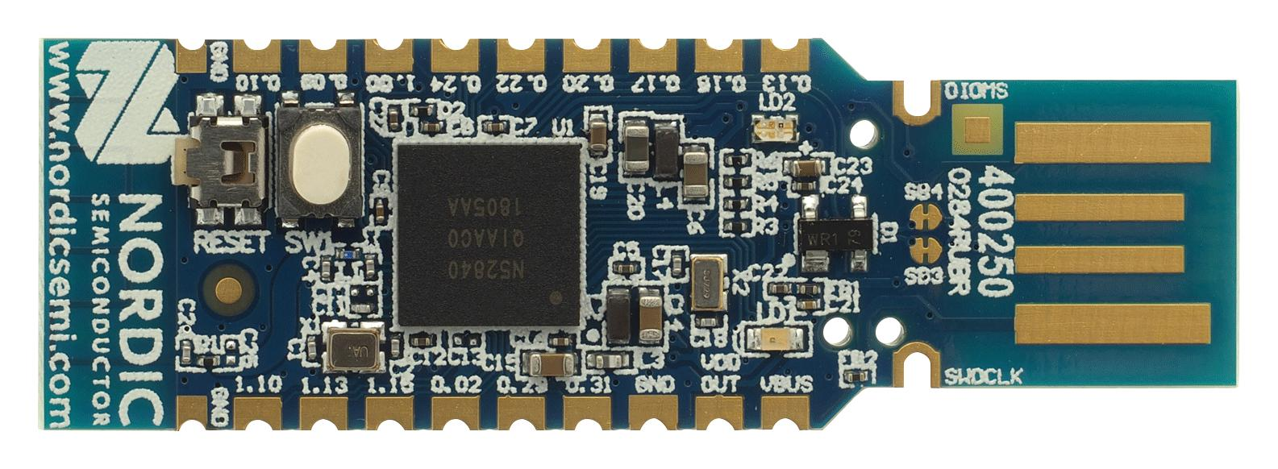
ESP32 BLE
nRF52840
BTM005

Slide 13
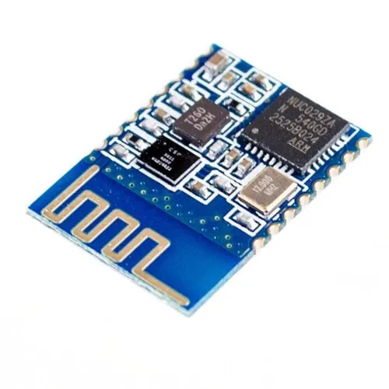
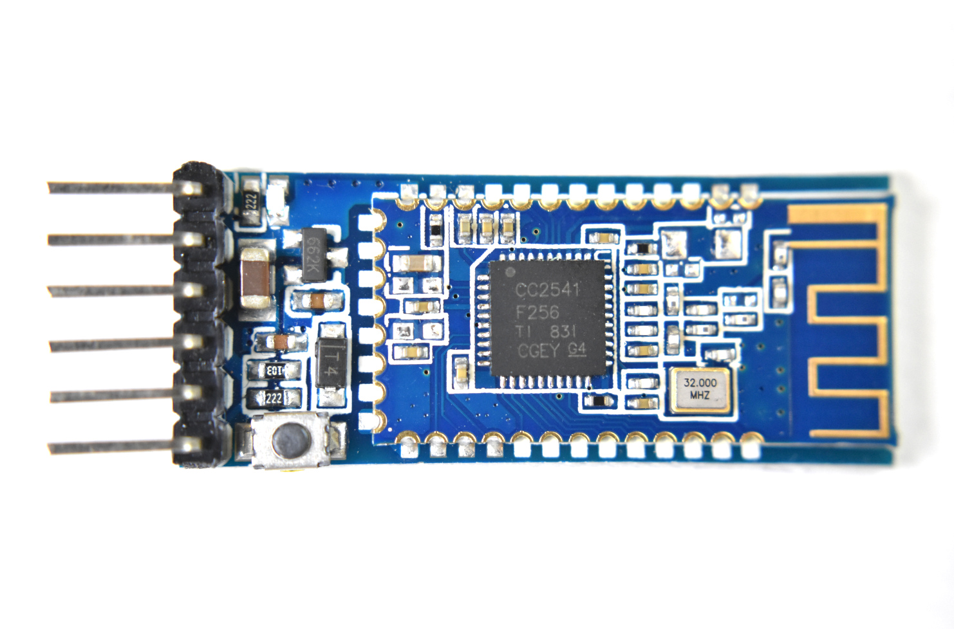
CC2541
HM-13

Slide 14
Bluetooth module benefits to organizations
Bluetooth modules benefit organizations by enabling seamless wireless communication, reducing wiring costs, and enhancing mobility.
They support automation, remote monitoring, and IoT integration, improving operational efficiency.
Their low power consumption and scalability make them ideal for smart devices, healthcare, logistics, and industrial applications, fostering innovation and real-time data exchange.

Slide 15
Why is Bluetooth module so important
Bluetooth modules are essential because they enable short-range wireless communication between devices, eliminating the need for physical cables.
They are widely used in applications like wireless audio, data transfer, healthcare monitoring, and smart home systems.
Their low power consumption makes them ideal for battery-operated devices, while their compact size allows easy integration into various electronics.
Bluetooth modules support reliable, secure communication and are compatible with most modern smartphones, tablets, and computers.

Slide 16
Challenges of Bluetooth module
Bluetooth modules, despite their advantages, face several challenges in practical applications.
One major issue is limited range, especially in environments with physical obstructions or interference from other wireless devices.
Data transmission speed may not be sufficient for high-bandwidth applications.
Security concerns also arise, as unauthorized access or data interception can occur if encryption is not properly implemented.

Slide 17
Additionally, compatibility issues may exist between different Bluetooth versions or devices.
Power consumption, while generally low, can still be a constraint in battery-powered systems.
Furthermore, integrating Bluetooth modules into embedded systems may require technical expertise, increasing development time and cost for organizations.

Slide 18
Advantages
Bluetooth modules offer numerous advantages for modern electronic systems.
They enable wireless communication between devices, reducing the need for complex wiring.
Their low power consumption makes them ideal for portable and battery-powered applications.
Bluetooth technology supports easy pairing and secure data exchange, enhancing user convenience and data safety.

Slide 19
With widespread compatibility across various devices like smartphones, laptops, and embedded systems, integration becomes seamless.
Bluetooth modules are cost-effective, compact, and versatile, making them suitable for applications in healthcare, automotive, consumer electronics, and IoT.
Their ability to support both point-to-point and mesh networking adds flexibility in creating smart and connected environments.

Slide 20
Disadvantages
Bluetooth modules, while useful, have several disadvantages.
Their communication range is limited, typically up to 10 meters for standard modules, which restricts long-distance applications.
Interference from other wireless devices, such as Wi-Fi or microwave ovens, can affect performance and lead to data loss. Data transfer rates are slower compared to technologies like Wi-Fi, making them less suitable for large file transfers.

Slide 21
Security vulnerabilities, if not properly addressed, can expose data to unauthorized access.
Additionally, compatibility issues between different Bluetooth versions can cause connectivity problems.
Power consumption, though low, can still impact battery life in continuous-use scenarios, especially in small devices.

Slide 22
Conclusion
In conclusion, Bluetooth modules are an integral part of our digital ecosystem, offering unparalleled convenience in wireless data transmission.
With applications spanning across various sectors and a pivotal role in emerging trends like IoT, their relevance continues to grow.
As consumers and businesses increasingly adopt wireless technology, understanding Bluetooth modules, their workings, and applications, becomes essential.
As we move forward, we can expect further advancements in Bluetooth technology that will continue to push the boundaries of wireless communication.

Slide 23


